Slide 1

Chapter 7: Design: Architecture and Methodology

Slide 2
Design Topics Covered
Architectural vs. detailed design
“Common” architectural styles, tactics, and reference architectures
Basic techniques for detailed design
Basic issues with user-interface design

Slide 3
Design
Starts mostly from/with requirements (evolving mostly from functionalities and other non-functional characteristics).
How is the software solution going to be structured?
What are the main components—(functional comp)?
Often directly from requirements’ functionalities (use cases).
How are these components related?
Possibly re-organize the components (composition/decomposition).
Two main levels of design:
Architectural (high level)
Detailed design
How should we depict design—notation/language?

Slide 4
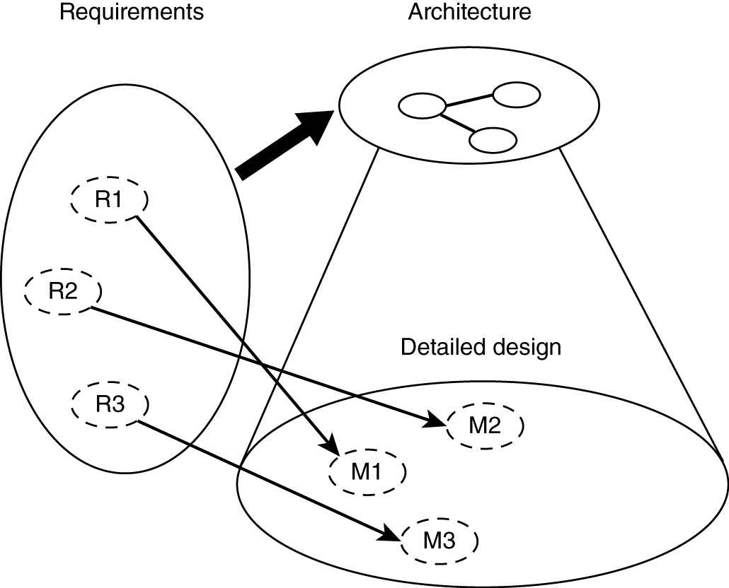
Relationship between Architecture and Design
Detailed Design
Comes from
Requirements &
Architecture

Slide 5
Software Architecture
Structure(s) of the solution, comprising:
Major software elements
Their externally visible properties
Relationships among elements
Every software system has an architecture.
May have multiple structures!
Multiple ways of organizing elements, depending on the perspective
External properties of components (and modules)
Component (module) interfaces
Component (module) interactions, rather than internals of components and modules

Slide 6
Views and Viewpoints
View – representation of a system structure
4+1 views (by Krutchen)
Logical (OO decomposition – key abstractions)
Process (run-time, concurrency/distribution of functions)
Subsystem decomposition
Physical architecture
+1: use cases
Other classification (Bass, Clements, Kazman)
Module
Run-time
Allocation (mapping to development environment)
Different views for different people

Slide 7
Architectural Styles/Patterns
We discuss architectural styles/patterns as
“reusable” starting point for design activities.
Pipes and filters
Event driven
Client-server
Model-view-controller (MVC)
Layered
Database centric
Three tier

Slide 8
Pipe-Filter Architecture Style
The high-level design solution is decomposed into two “generic” parts (filters and pipes):
Filter is a service that transforms a stream of input data into a stream of output data.
Pipe is a mechanism or conduit through which the data flows from one filter to another.
Input
time cards
Prepare for
check processing
Process checks
** Reminds one of DFD without the data store or source sink.**
Problems that require batch file processing seem to fit this architecture: e.g., payroll, compilers, month-end accounting.

Slide 9
Event Driven (Real Time)
The high-level design solution is based on an event dispatcher, which manages events and the functionalities that depend on those events. These have the following characteristics:
Events may be a simple notification or may include associated data.
Events may be prioritized or be based on constraints such as time.
Events may require synchronous or asynchronous processing.
Events may be “registered” or “unregistered” by components.
voice
call
Phone
processing
text
msg
Personal (device)
dispatcher
Text
processing
Image
keypad
Image
processing
Problems that fit this architecture include real-time systems such as: airplane control,
medical equipment monitor, home monitor, embedded device controller, game, etc.
- - - Try a commercial flight control system - - -

Slide 10
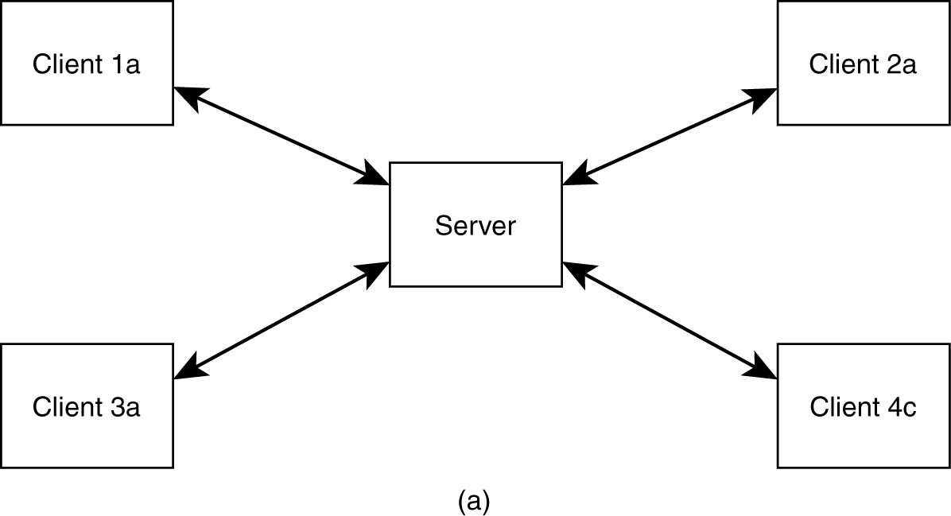
Basic Client-Server Style
Application split into client component and server component.

Slide 11
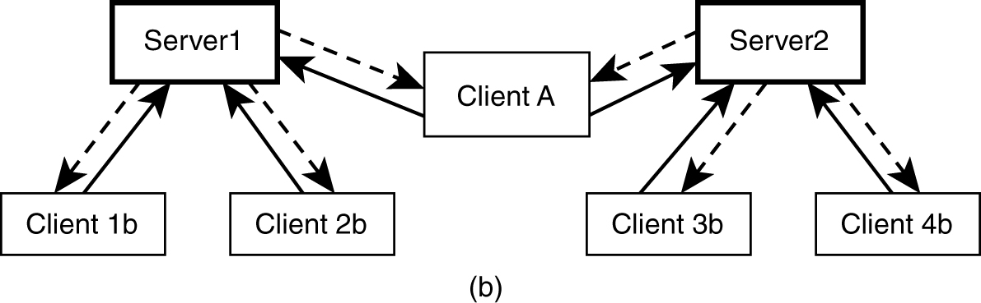
Client-Server Style
Client may connect to more than one server (servers are usually independent).

Slide 12
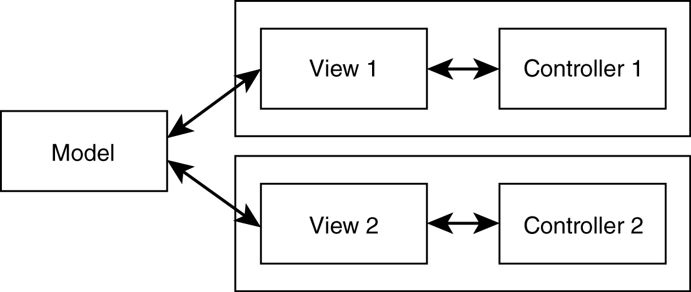
Model-View-Control (MVC) Style
Separates model (data) from view.
Controller often integrated with view nowadays.
Most internet web applications fall under this style.

Slide 13
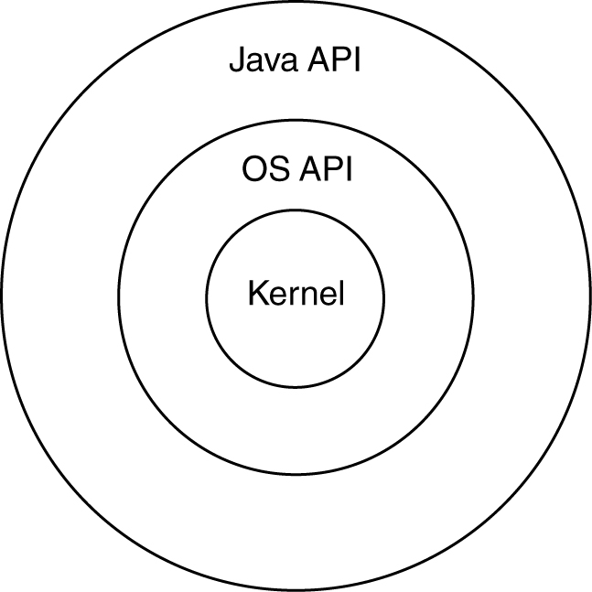
Layered Style
The “outer” layer can only ask for service from the “inner” layer; the “upper” layer can only ask for service from the “lower” layer.
− Strict layering: only directly inside or below layers
− Relaxed layering: any inside or below layers

Slide 14
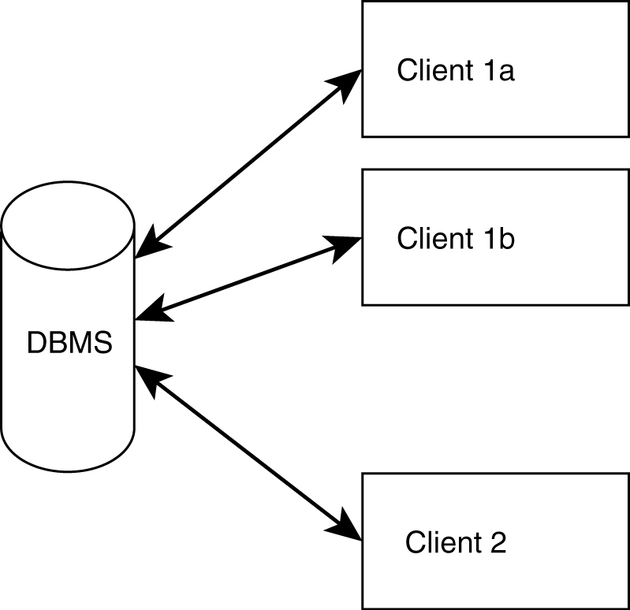
Shared Data (DB)-Centric Style
Very popular within the business applications community

Slide 15
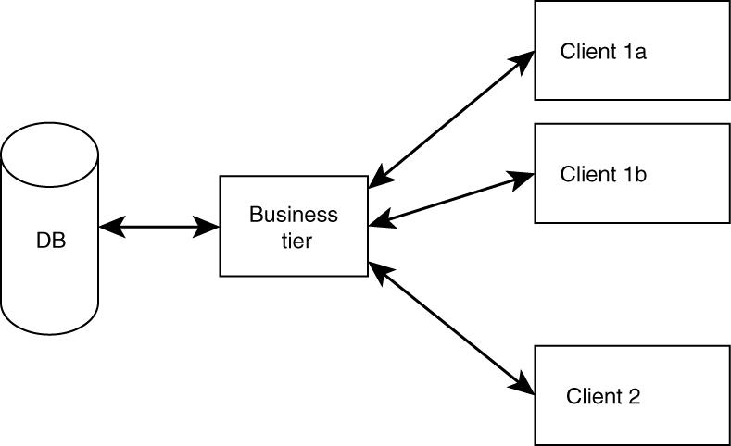
Three-Tier Style (Mixture)
Clients do not access DB directly.
Better flexibility, integrity. (Why?)
Reminds one of client server or MVC.

Slide 16
Architectural Tactics
Tactics (in contrast to architectural style) are for solving “smaller, specific” problems.
Do not affect overall structure of system.
Example: we add specific functionalities or component (e.g., to increase reliability) in the design for fault detection—especially for distributed systems:
Heartbeat
Ping/echo

Slide 17
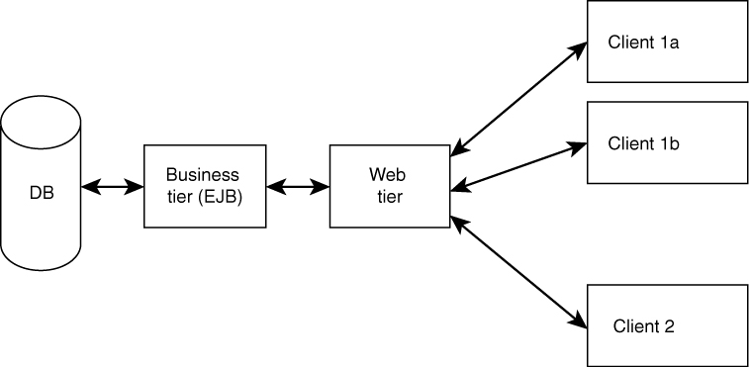
Reference Architectures
Full-fledged architectures.
Serve as “templates” or as “a reference” for a class of systems.
Example: J2EE reference architecture (MVC2).
There also are “application domain−specific” reference architectures.

Slide 18
Detailed Design
Further refine architecture and match with requirements.
How detailed?
How formal?
Maybe of different levels of detail for different views.

Slide 19
Functional Decomposition Technique
Dates back to “structured programming” [now (non-OO) Web apps with PHP tool].
Start with: main (task/requirements) --> module.
Refine into sub-modules.
There are alternative decompositions.

Slide 20
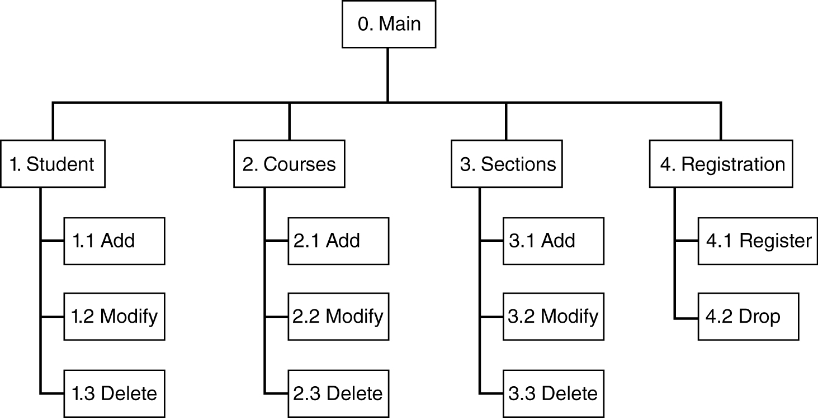
Possible Decomposition of (Student-Course Management App)

Slide 21
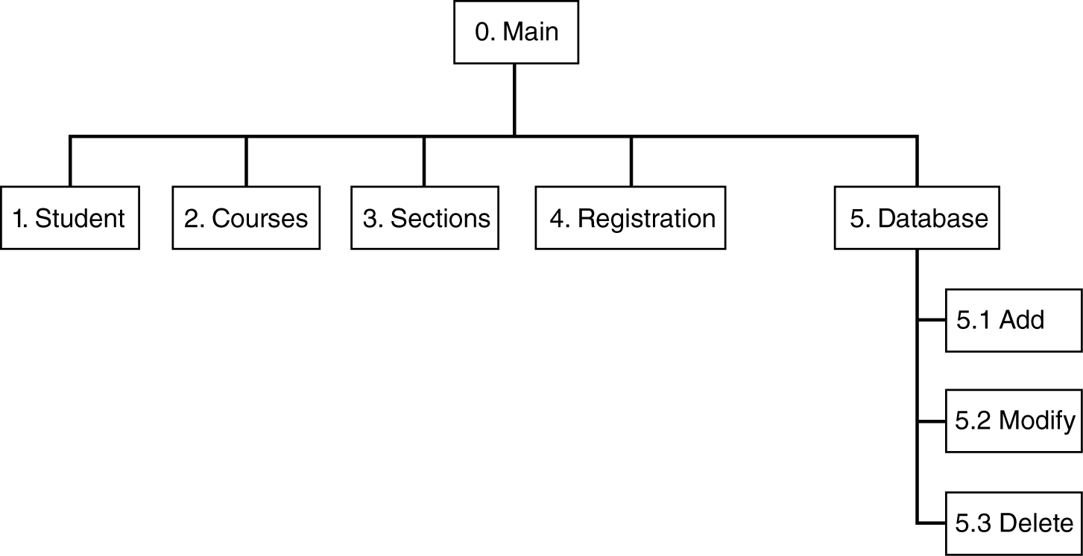
“Alternative” Decomposition/Composition

Slide 22
Relational Database Design
Most databases use relational technology.
Relations (tables):
Two-dimensional sets
Rows (tuples), columns (attributes)
A row may be an entity; columns may be relationships or attributes.
Primary key (unique identifier) – for search
Foreign keys (connects tables)

Slide 23
Database Design
Conceptual modeling (done during analysis/requirement phase) produces ER diagram.
Logical design (to relational).
Physical design (decide data types, etc.).
Deployment/maintenance:
Low-level physical (which hard drive, etc.)
Adjustment of indexes

Slide 24
Entity-Relationship Diagrams
Entities (rectangles)
Weak: double lines
Relationships (diamonds)
Attributes (ovals)
Multi-valued: double lines
Identifying: underlined

Slide 25
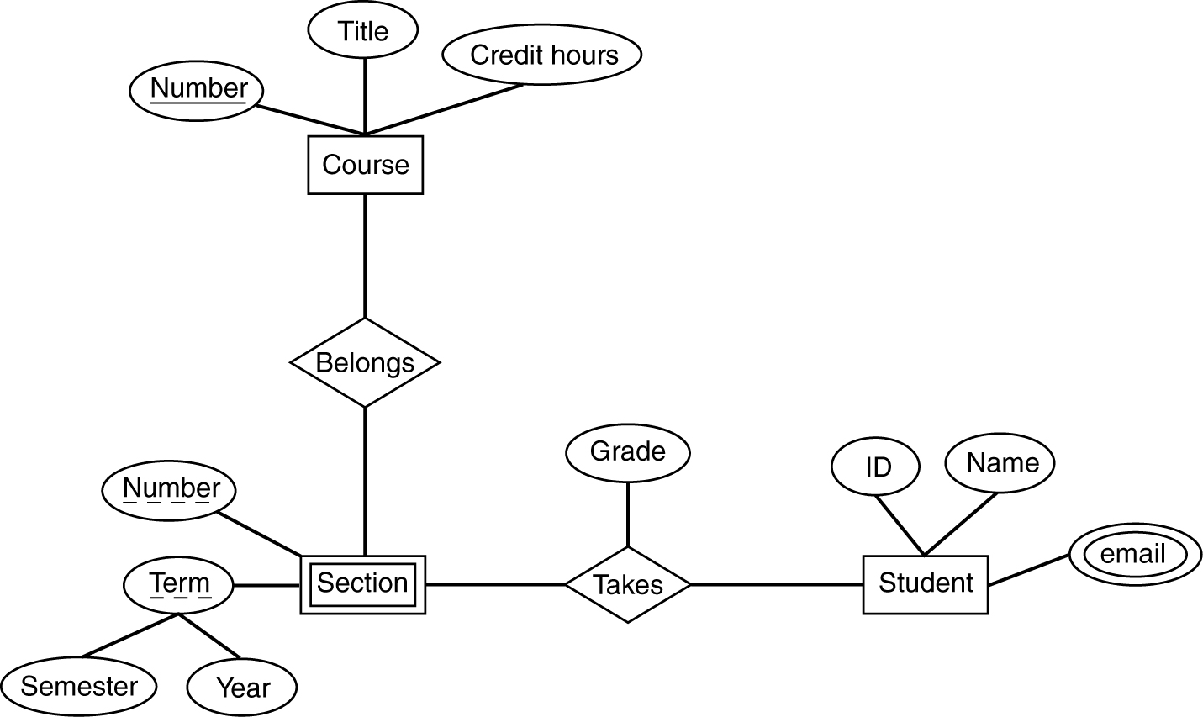
ER Diagram Example

Slide 26
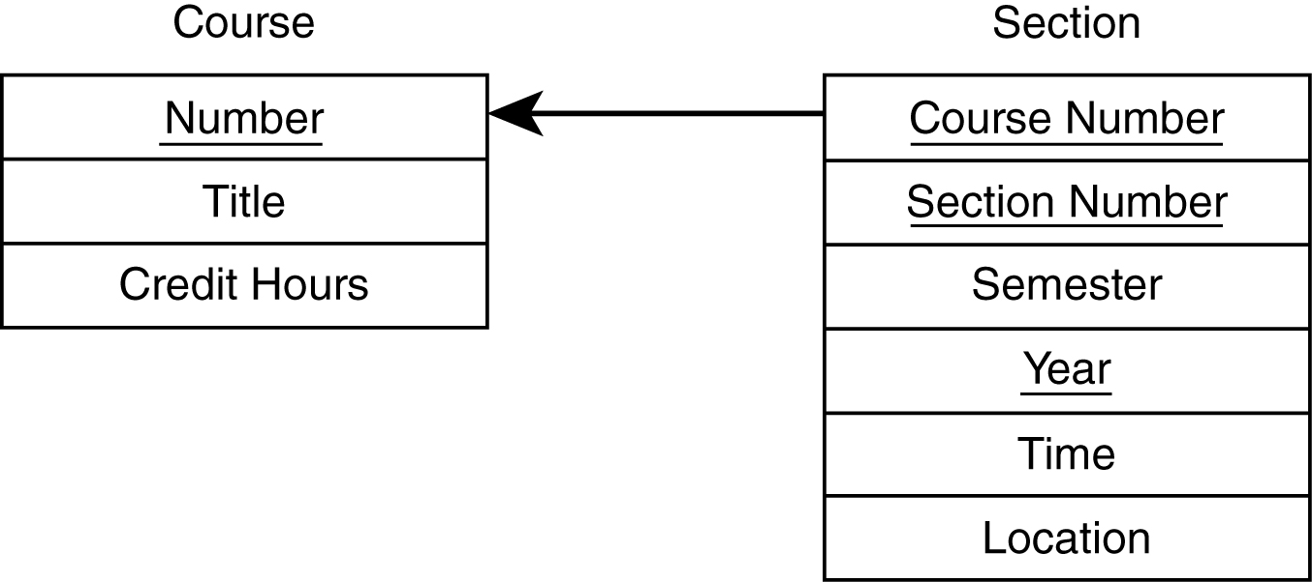
Logical DB Design – Entities
Table per entity.
Flatten composite attributes.
For weak entities, add the primary key of the strong entity.

Slide 27
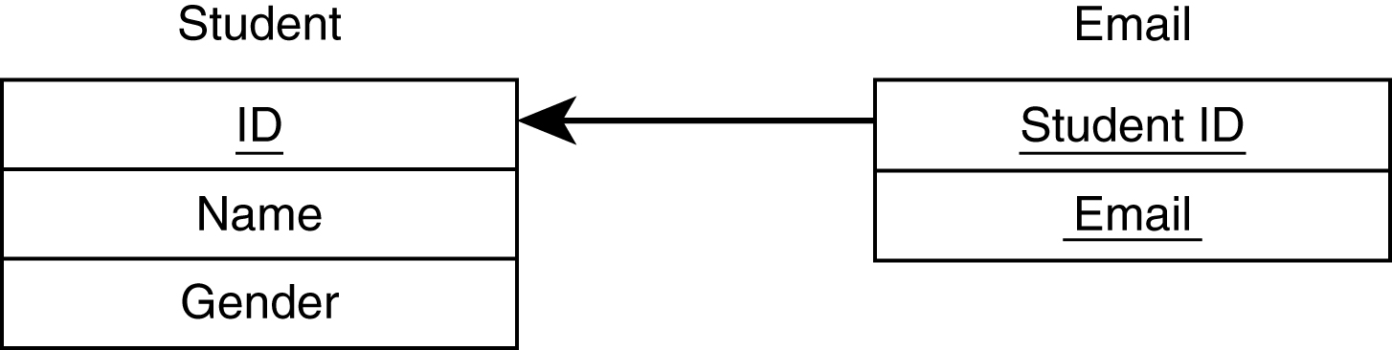
Logical DB Design – Multi-Valued
New table needed for multi-valued attributes.

Slide 28
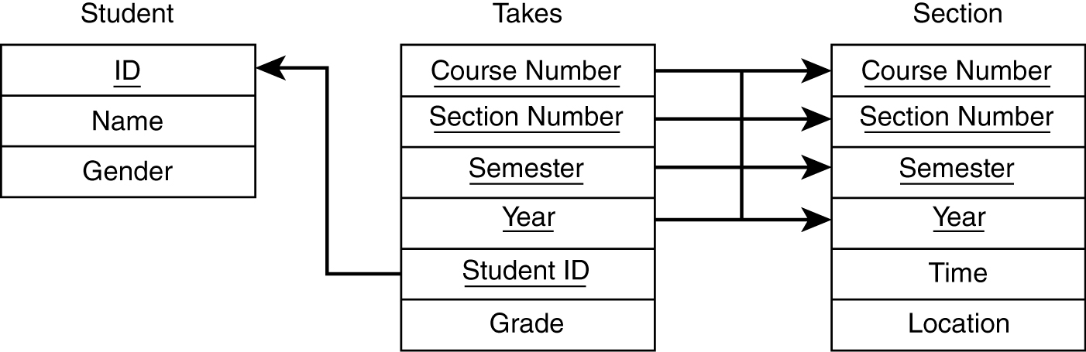
Logical DB Design – Relationships
If one side related to just one entity, add foreign key to that side.
For many to many, need new table.
For ternary, need new table.

Slide 29
Physical DB Design
Data types for each attribute.
Check which ones your DBMS support.
Encoding.
Decide on indexes.
Searches are faster, updates are slower.
Indexes consume space.
Can always adjust during deployment.
Denormalization done sometimes (avoid).

Slide 30
OO Design
First step: review and refine use cases.
Decide:
Which classes to create
How are the classes related
Use UML as the design language.

Slide 31
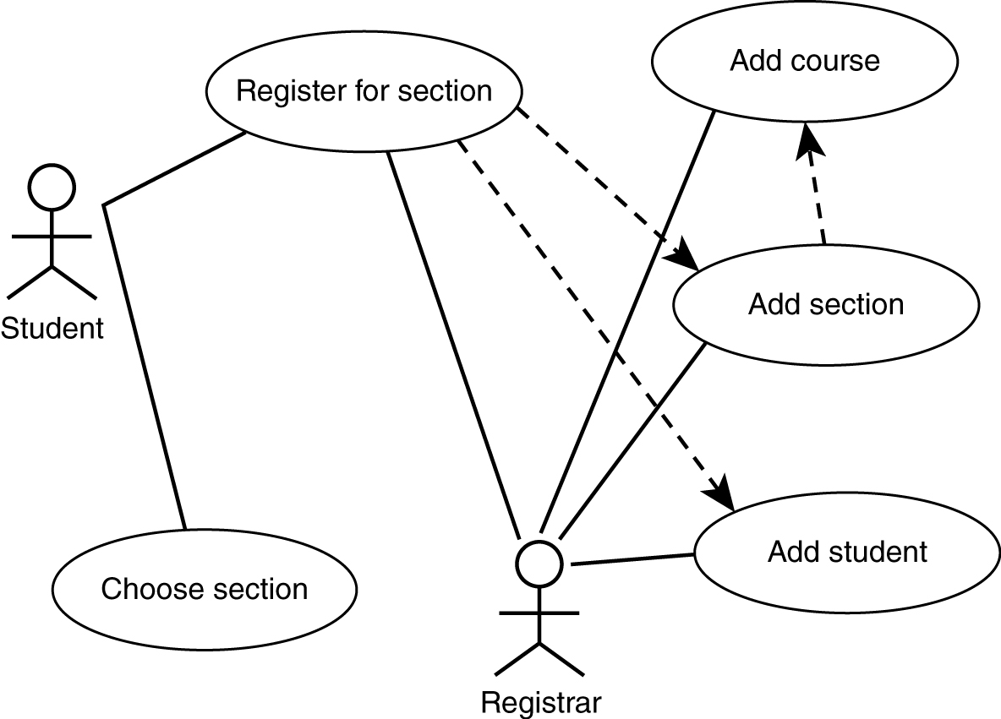
Use Case Diagram

Slide 32
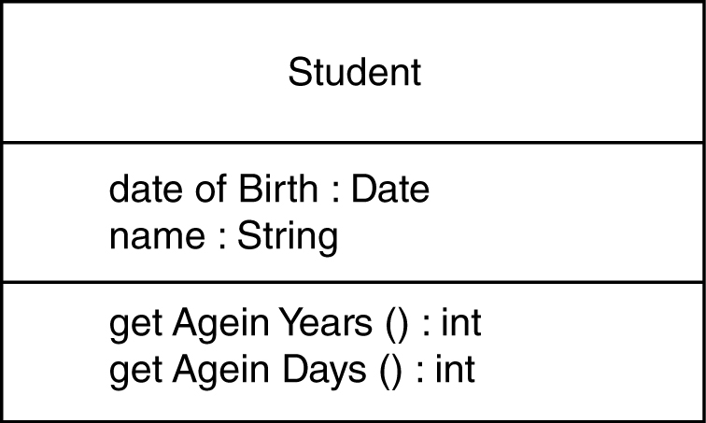
Class Design
Classes represent real-world entities or system concepts.
Organized into classes: objects in a class have similar characteristics.
Classes have properties (attributes or data).
Classes also have methods (perform functions).

Slide 33
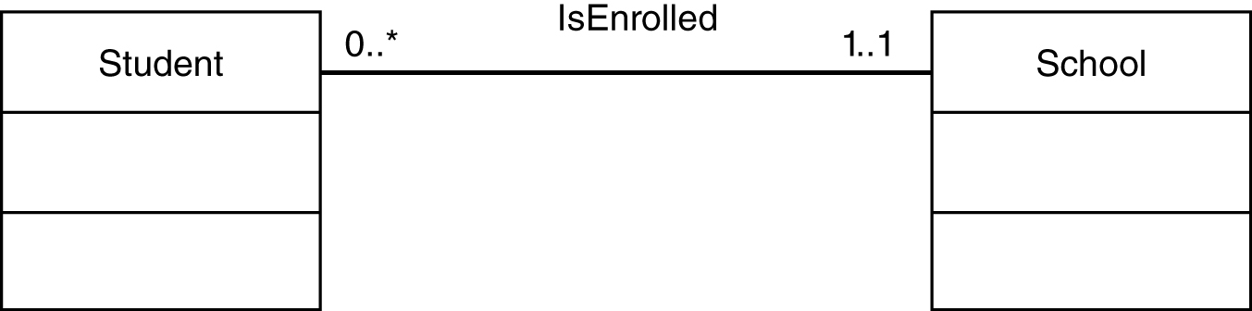
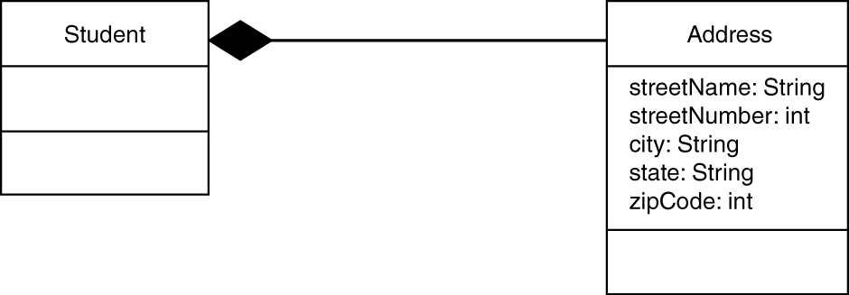
UML Class Diagrams
Association
Composition
Use “no-fill” diamond for aggregation.

Slide 34
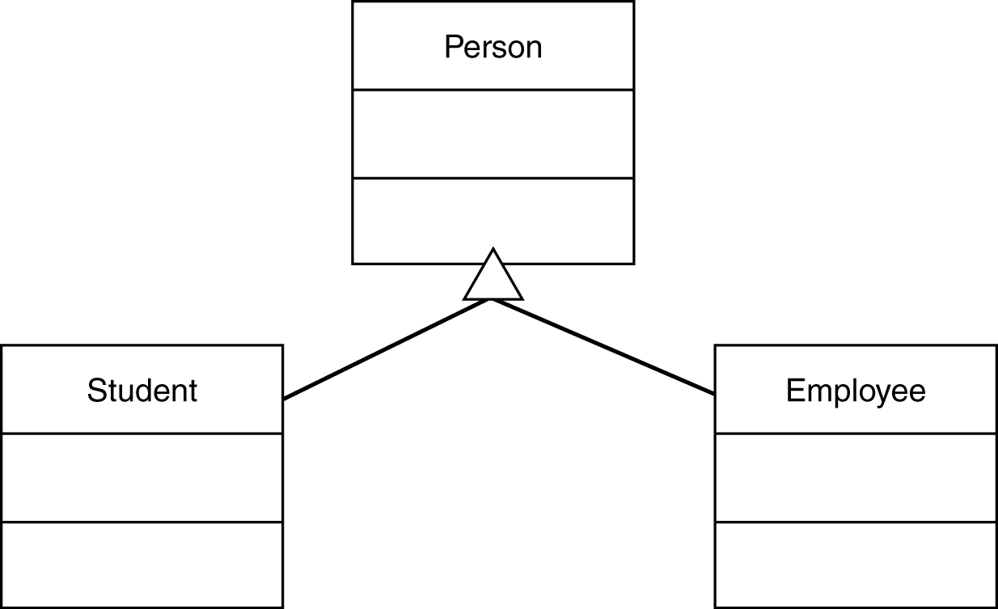
UML Class Diagrams – Inheritance

Slide 35
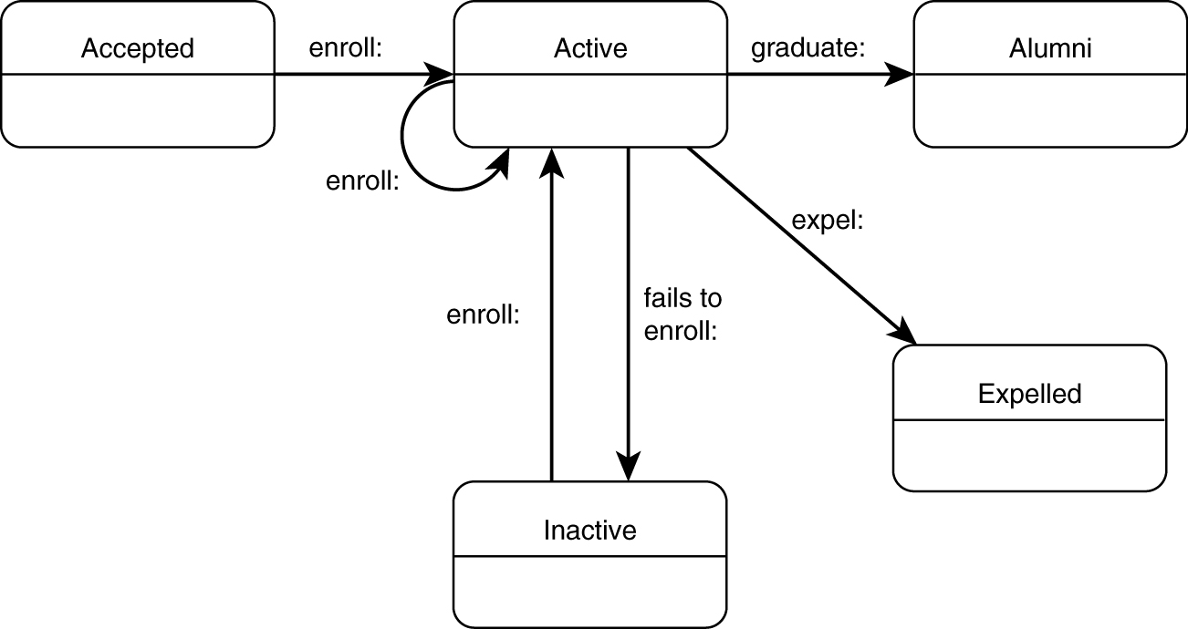
UML State Diagram
depicting a student’s “status” in school

Slide 36
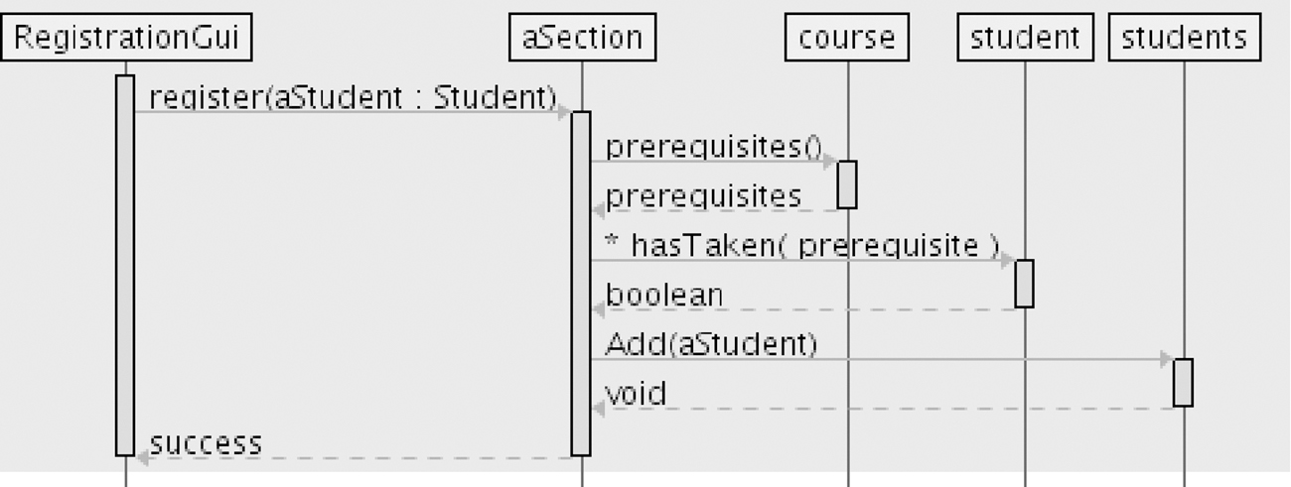
UML “Sequence Diagram”
used to depict a flow of interactions

Slide 37
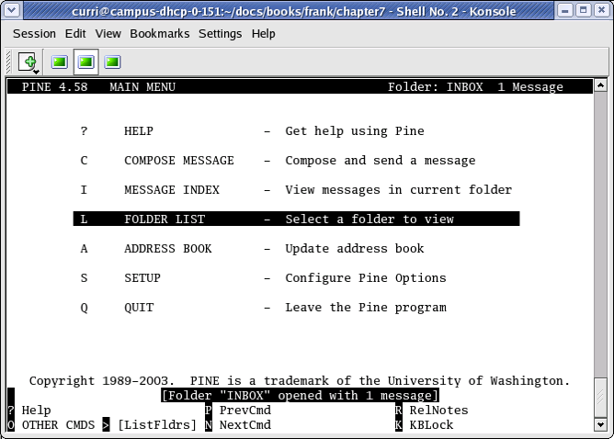
User Interface Design
Most apparent to the user
Two main issues:
Flow of interactions
ii) Look and feel
Types of interfaces
Command-line
Text menus
Graphical (GUI)

Slide 38
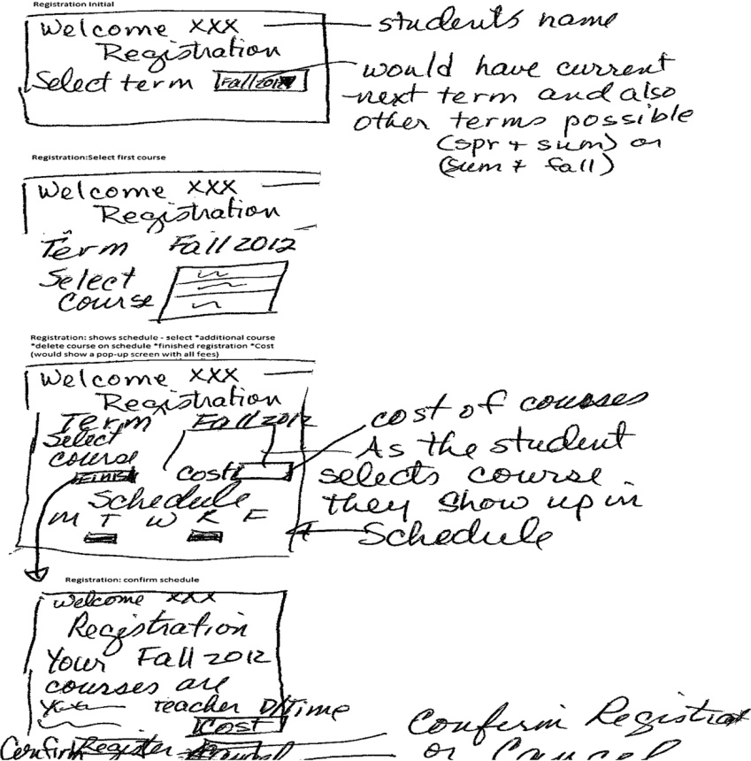
Flow of Interactions
Prototype screens
Registration:
Select term.
Registration: shows term.
Select first course.
Registration: shows term, course(s) with schedule and cost.
Select *Additional course; *Delete course; *Finish registration.
Registration: shows final schedule.
Select Confirm or Cancel.

Slide 39
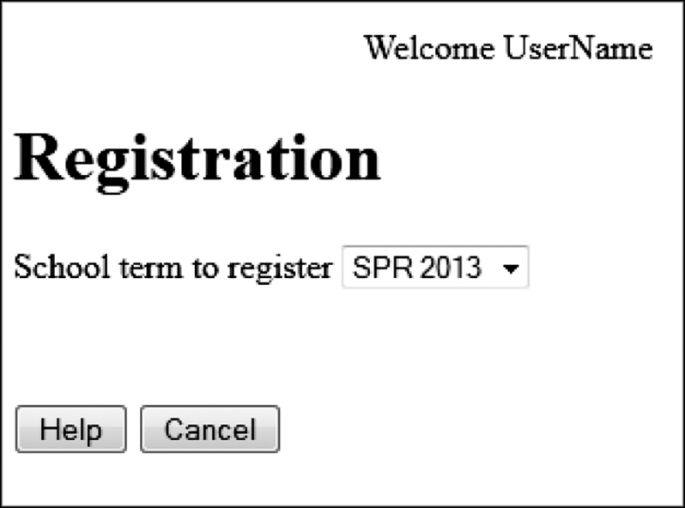
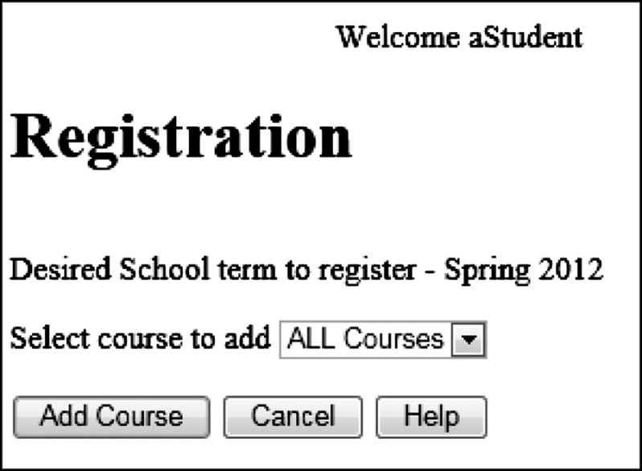
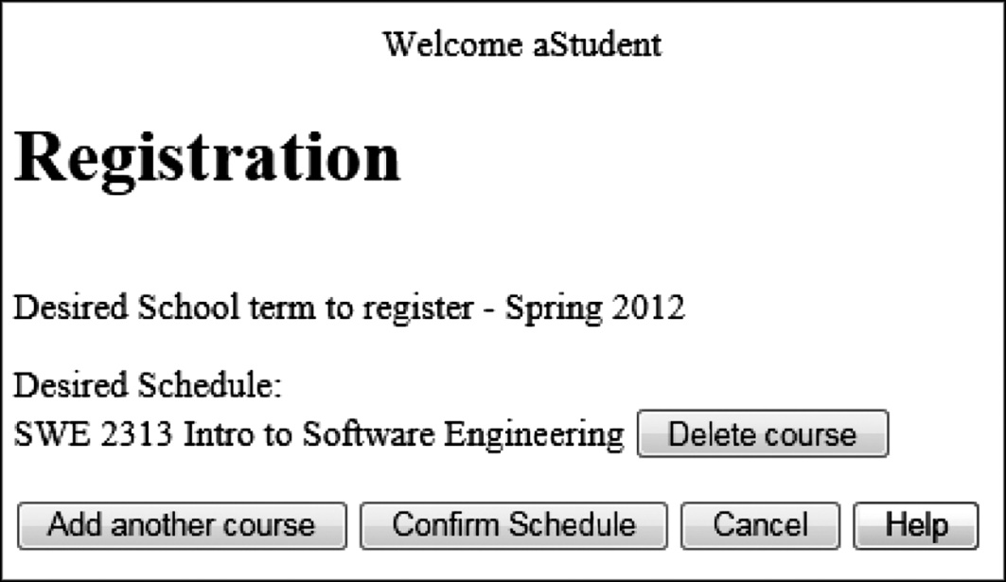
High Fidelity Prototype

Slide 40
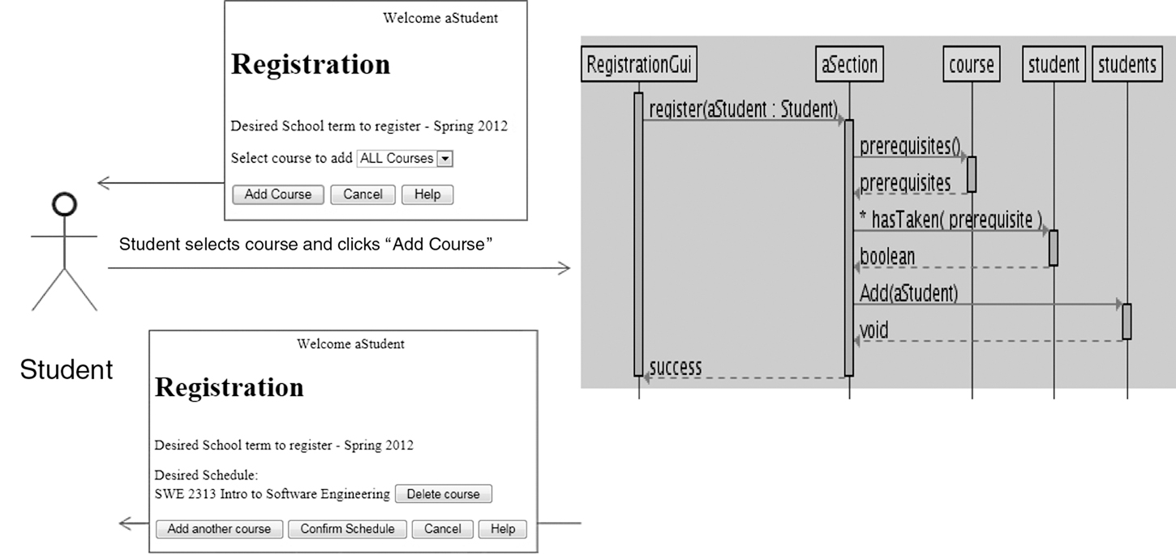
User: Screens: Process:

Slide 41
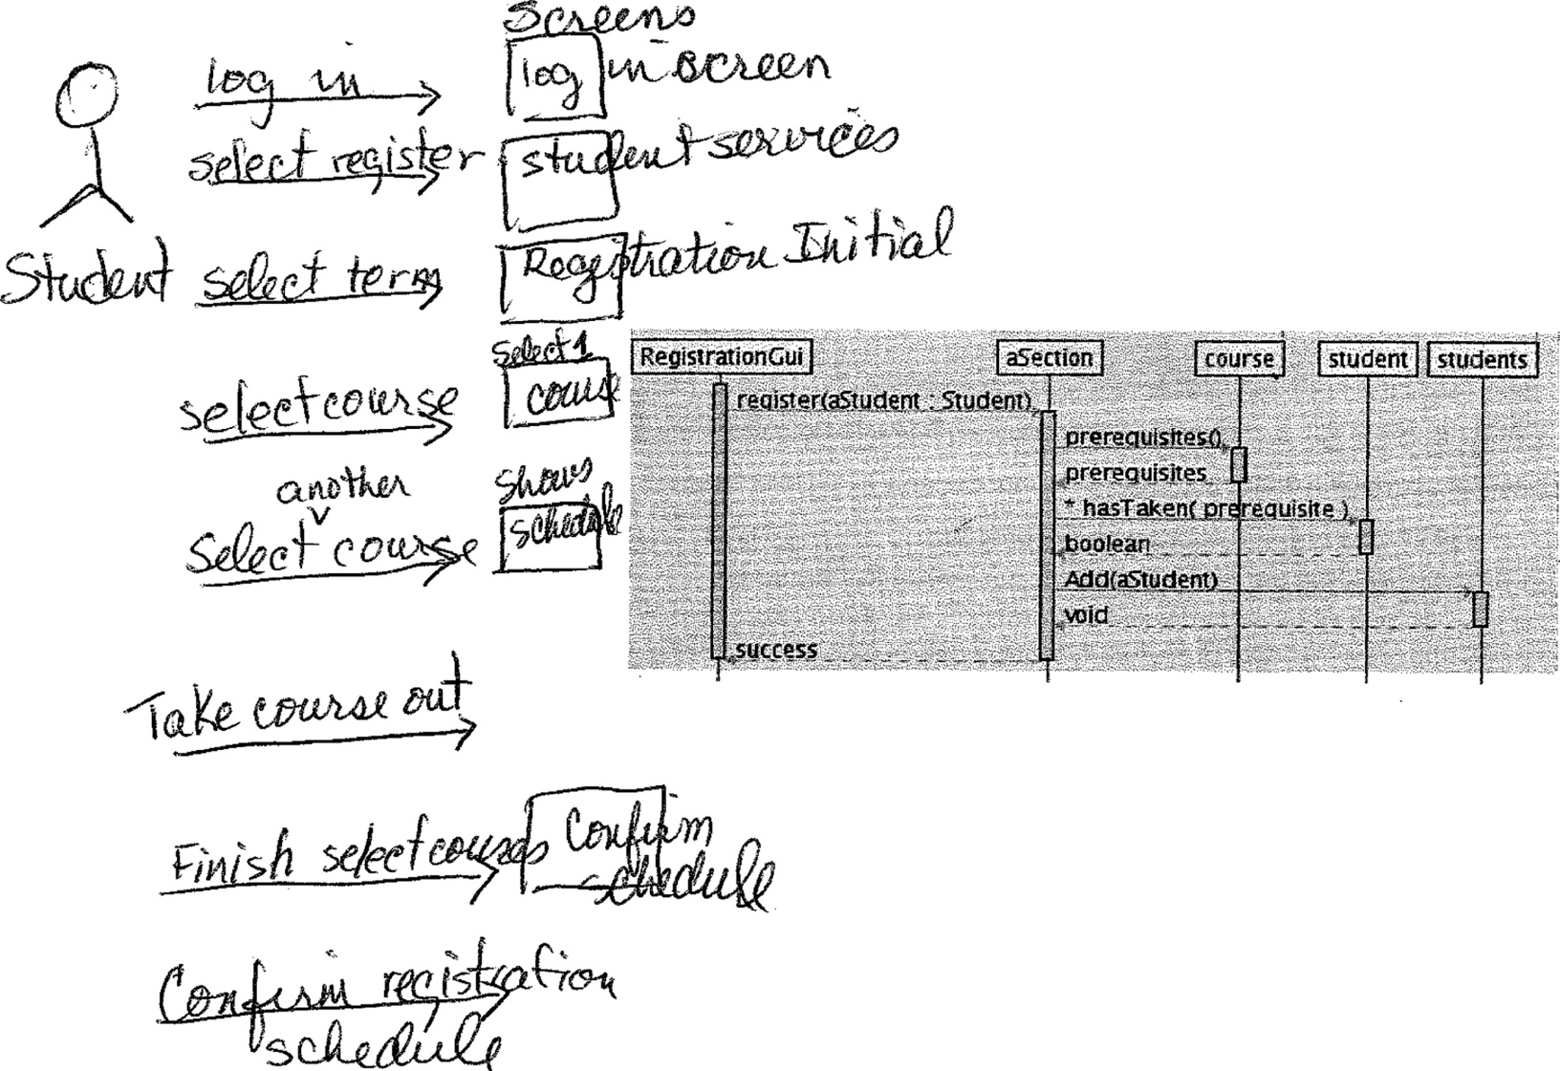
User Interaction Added to the Sequence Diagram

Slide 42
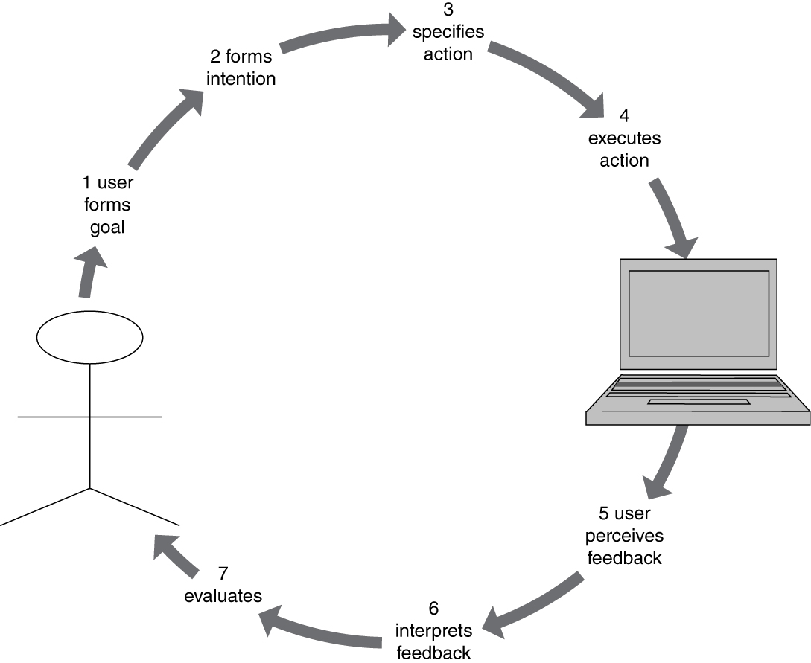
Norman’s 7 Stage Model

Slide 43
The GOMS Model (an “advanced” topic for UI)
Consider different kinds of users.
Four factors (for the kind of user)
Goals of the user
Operations provided by the system
Methods or the sequence of operations
Selection rules for the methods

Slide 44
Other UI Issues
Kinds of users
Heuristics
UI guidelines
Multicultural issues
Metaphors
Multiplatform software
Accessibility
Multimedia interfaces

Slide 45
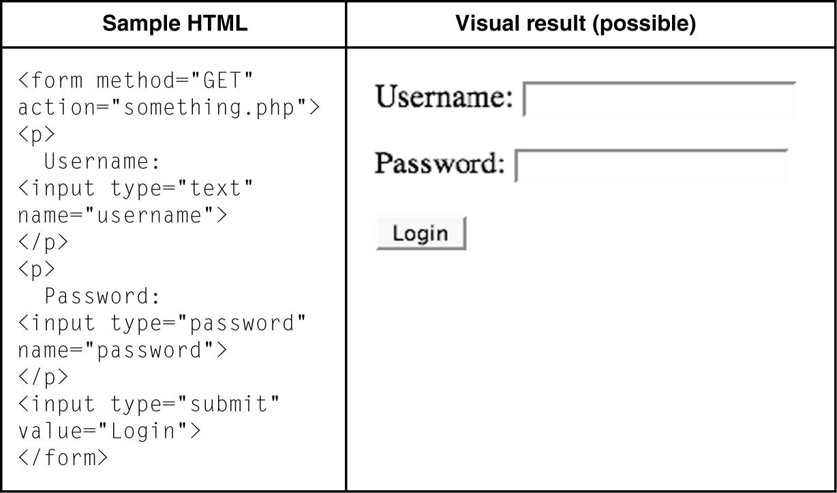
HTML Script Simple Example

Slide 46
Model-View-Controller (MVC) Software Project
View HTML
Controller PHP
Model
SQL database

Slide 47
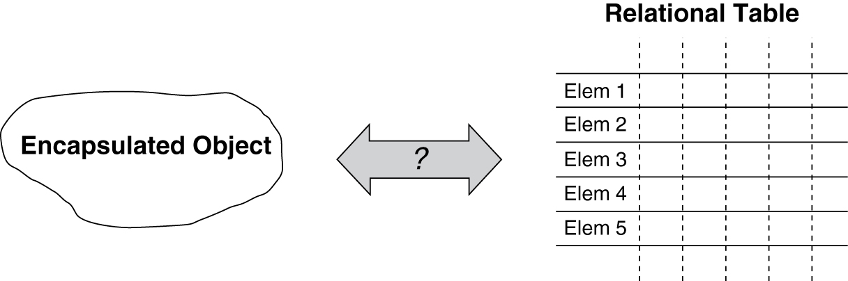
Object-Relational Impedance Mismatch (an “advanced” topic)
How do we handle mismatches between object-oriented concepts and relational DB such as:
Typing
Private and public
Inheritance and polymorphism
Nested structure versus table structure

